Slide 1
Data Science at the Enterprise Scale with Apache Spark
Jerome Nilmeier, PhD
Data Scientist and Engineer
Spark Technology Center
Cognitive Open Technologies Group
nilmeier@us.ibm.com
@JNilmeier
Notes:
Hi All,

Slide 2

Getting Started with Python
Course Materials Link: http://bit.ly/DSatESwithSpark
https://www.anaconda.com/download
To run: /my/path/to/anaconda/bin/python
(same for pip and jupyter-noteboook)
Getting Started with Data Science Experience
http://datascience.ibm.com/
Sign up for a Free Account

Slide 3
Getting Started with Apache Spark
Course Materials Link: http://bit.ly/DSatESwithSpark
Make sure java (preferrably java 8) is installed Java 9 will not work!
Go to https://spark.apache.org/downloads.html
Download Pre-built Apache Hadoop 2.7 and later
“export SPARK_HOME=/my/path/spark-2.2.0-bin-hadoop2.7” to ~/.bash_profile
At command line type $SPARK_HOME/bin/spark-shell
If that works, we’re good to go!
Course Materials Link: http://bit.ly/DSatESwithSpark

Slide 4
Getting Started with SystemML
Course Materials Link: http://bit.ly/DSatESwithSpark
Go to http://systemml.apache.org/download
Download systemml-0.14.0-incubating.tgz (Binary tgz)
Unzip to location and add
“export SYTEMML_HOME=/my/path/systemml-0.14.0/” to ~/.bash_profile
At command line type
$SPARK_HOME/bin/spark-shell --jars $SYSTEMML_HOME/libs/systemml-0.14.0-incubating.jar
Or
bash startSparkWithSystemML.sh (which has some recommended memory settings)
Try importing systemml at REPL: scala> import org.apache.sysml
Browse Notebook Examples on github! http://systemml.apache.org/get-started

Slide 5
Recommended Reading Links
Course Materials Link: http://bit.ly/DSatESwithSpark
Spark documentation
Apache Website
Learning Spark
Matei Zaharia, Patrick Wendell, Andy Konwinski, Holden Karau
Just Enough Scala for Spark
Oriole Online Tutorial by Dean Wampler
Cognitive Class online courses:
Spark Fundamentals I
Spark Fundamentals II

Slide 6


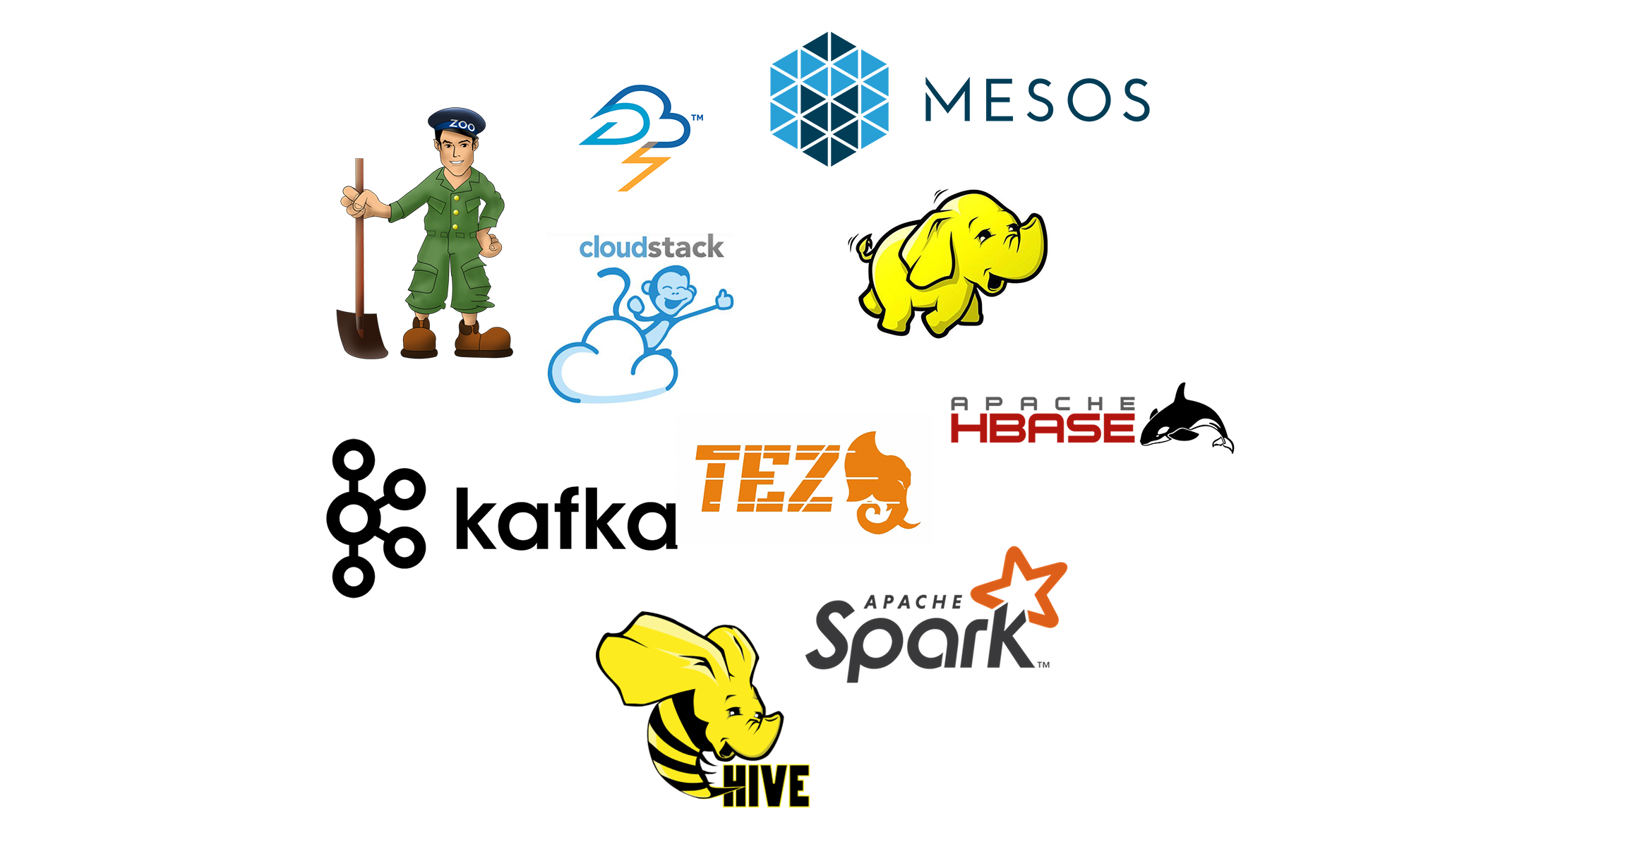
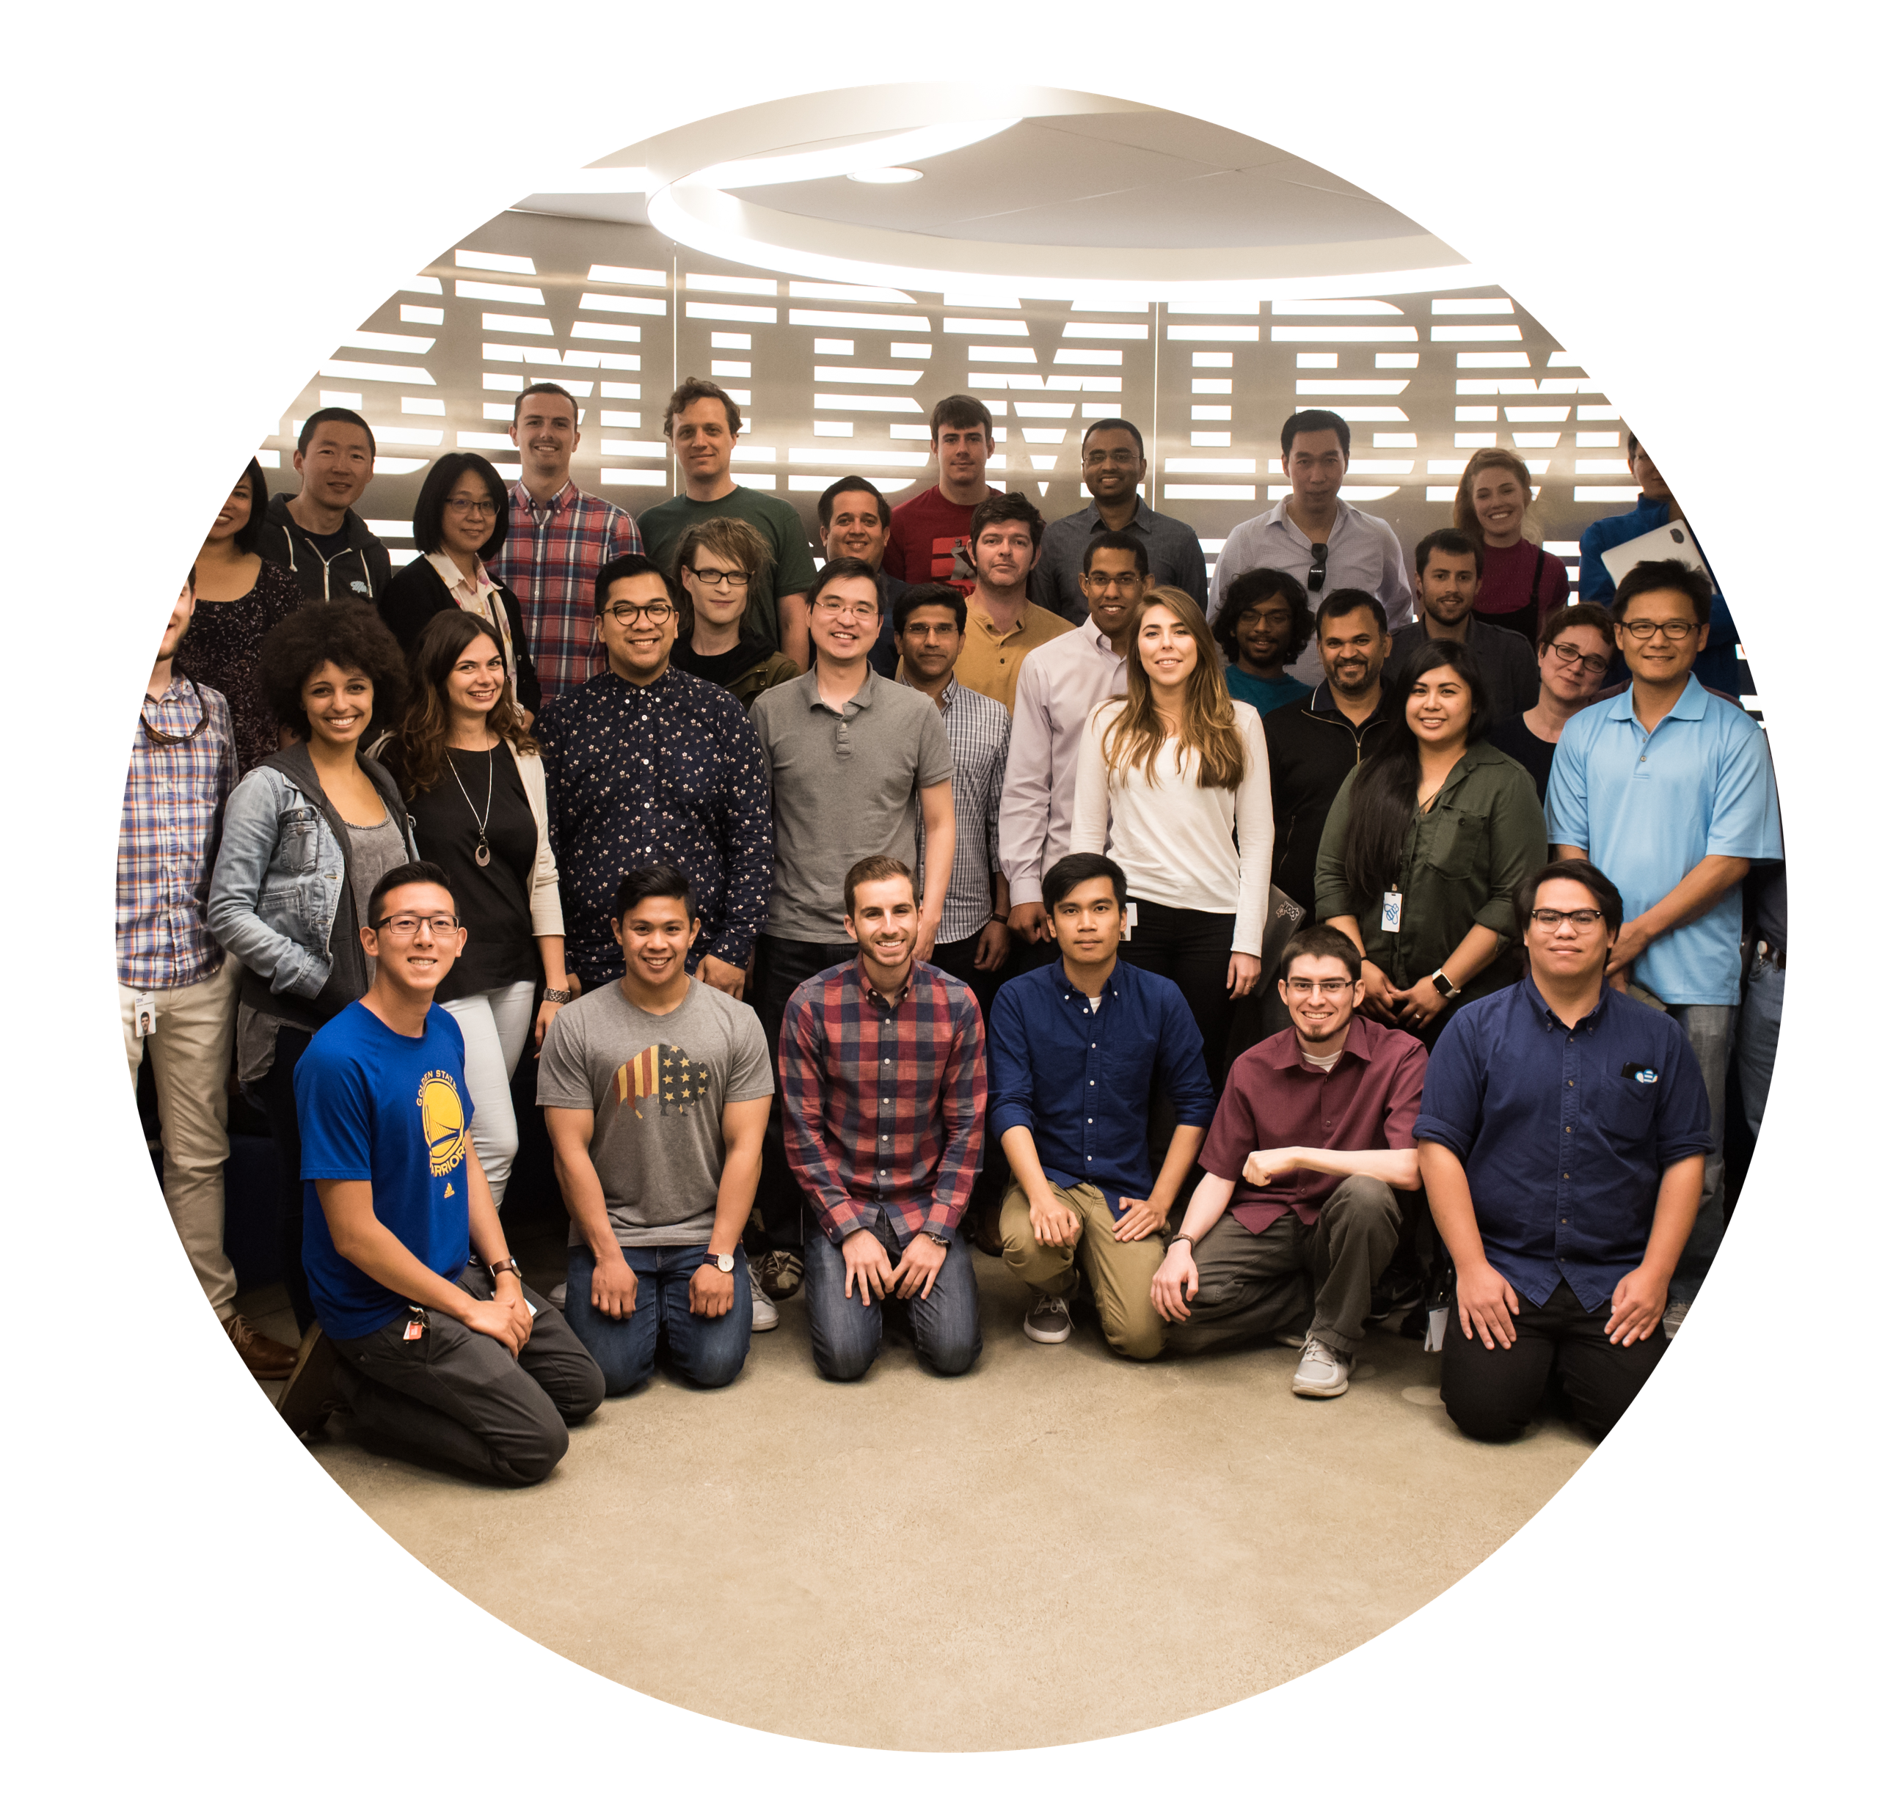


Open Source Community Leadership
Founding Partner
188+ Project Committers
77+ Projects
Open Source
Key Open source steering committee memberships
OSS Advisory Board
Spark Technology Center

Slide 7

About Me
Jerome Nilmeier
2015- Present: Data Scientist/Engineer, Spark Technology Center
2002: B.S. Chemical Engineering
UC Berkeley
2008: Ph.D. (Computational Biophysics), UC San Francisco
2009-2015: Postdoctoral Appointments:
- UC Berkeley
- Lawrence Berkeley/Livermore National Labs,
- Stanford OpenMM Fellow
- Insight Data Engineering Fellow

Slide 8
Contents
Day 1
Day 2
Spark Ecosystem
SparkSQL
Machine Learning:
Mllib, ML, SystemML
GraphX
Spark Streaming
SparkR and R4ML
What is Spark?
Let’s Learn some Python!
Let’s Learn Some Scala!
Components of Spark
Resilient Distributed Datasets
Course Materials Link: http://bit.ly/DSatESwithSpark

Slide 9
What is Spark?

Slide 10
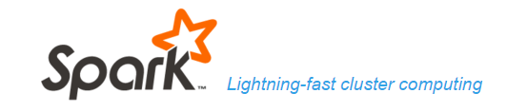
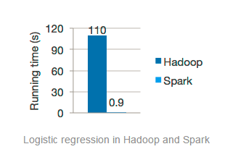
What is Spark?
Cluster computing framework for large scale data processing and analysis
Provides parallel distributed processing, scalability and fault tolerance on commodity hardware
Fast in speed due to in-memory processing
Comprehensive, unified framework to manage big data processing
Easy to use: APIs in Python, Scala, Java
Written in Scala and runs on a JVM

Slide 11

Spark Technology Center
What is Apache Spark?
Spark is an open source
in-memory
application framework for
distributed data processing and
iterative analysis
on massive data volumes

Slide 12


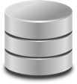




Motivation for Apache Spark
Traditional Approach: MapReduce jobs for complex jobs, interactive query, and online event-hub processing involves lots of (slow) disk I/O
Solution: Keep more data in-memory with a new distributed execution engine
HDFS Read
Iteration 1
HDFS Write
HDFS Read
Iteration 2
HDFS Write
Input
CPU
Memory
CPU
Memory
Result
Zero Read/Write Disk Bottleneck
Chain Job Output into New Job Input
HDFS Read
Iteration 1
Iteration 2
Input
CPU
Memory
CPU
Memory
Notes:
Spark's solution is to remove storage on disks from the execution framework altogether. Ultimately, you may want to persist the final product of your computations to disk - or perhaps you won't require this at all. It's up to the determination of the programmer to decide what best fits their use case and whether they wish to persist the results for long-term storage. The key is that the execution & processing framework excludes these performance-hampering reads & writes from spinning disks altogether.
Once data has been loaded into Spark (for example, that initial load we see in the example above, just prior to Iteration 1), data is swapped between the CPU(s) and memory (RAM) as results are calculated. The output of that Iteration, however, does not need to be written back to disk – it can be stored temporarily (cached) in memory! And where Spark is truly unique is its ability to chain together multiple jobs (Iterations) without ever needing to write or read data from disk. The output of Iteration 1 can be piped directly as input into Iteration 2, and so on. This is incredibly powerful, performance, and opens the door to the type of use cases that Spark is able to address: interactive query, micro-batch streaming, and more are now possible, as a result of bypassing Hadoop's disk-dependency.

Slide 13
History of Spark
Originated as a research project in 2009 at UC Berkeley AmpLab
Motivated by MapReduce and need to apply Machine Learning in a scalable fashion
Open sourced in 2010 as an Apache project
Top-level Apache open source project today
IBM’s commitment to promote open source innovation and accelerate intelligence into every application

Slide 14
Data Analysis with Spark
Interactive queries
Batch processing
Iterative machine learning algorithms for predictive analytics
Real time data processing via streaming
Various data sources supported
Used by Data Scientists, support for invoking external programs in Matlab and R
Used by Data Engineers: hides complexity of distributed system programming, network communication simplifying parallelizing applications across clusters.

Slide 15
Let’s Learn Some Python!

Slide 16
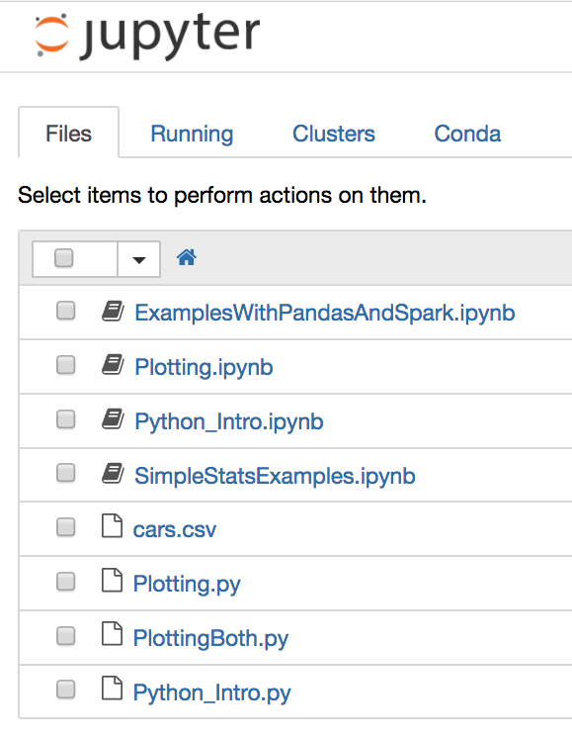
Getting Started With Python
To open notebook type: jupyter-notebook
Files with:
.ipynb extensions are python notebooks
.py extensions are python scripts

Slide 17
Let’s Learn Some Scala!

Slide 18
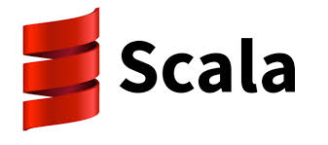
Why Scala?
Apache Spark is written completely in scala!
Scala compiles to JVM bytecode
All java libraries can be directly imported
Scala code can be decompiled (using javap –p) to java code
Code is easier to read and maintain, yet still statically typed
REPL provides rapid prototyping environment
Show comparison of code
Type Safety allows for compile time error handling
Threadsafe coding is baked into syntax

Slide 19
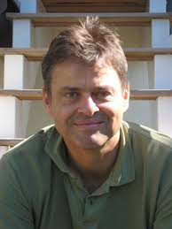
Martin Odersky Creator of Scala
Why Scala?
Late 90s: Trying to make Java better, e.g. java compiler, generics
2001 decided to make a better Java
2003 first experimental release
2005 Scala 2.0 written in Scala
2011 Scala 2.9 released
Typesafe founded (now Lightbend)
Today Scala 2.12 on Java 8
Tomorrow…Java 9
scala is a more compact and readable formulation of java
(show example)

Slide 20
The Read Evaluate Print Loop (REPL)
The best entry point into scala and/or spark (via spark-shell)
Exploration of variables
Tab autocompletes to reveal methods for every object

Slide 21
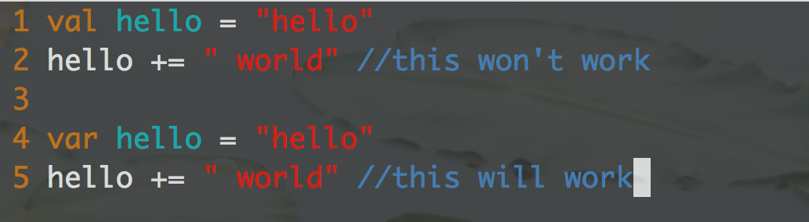
Immutability
Immutable Data Types: An important aspect of any thread safe (parallel) program
All RDDs in Spark are immutable
var is available when needed however
simpleSyntaxExamples.scala

Slide 22
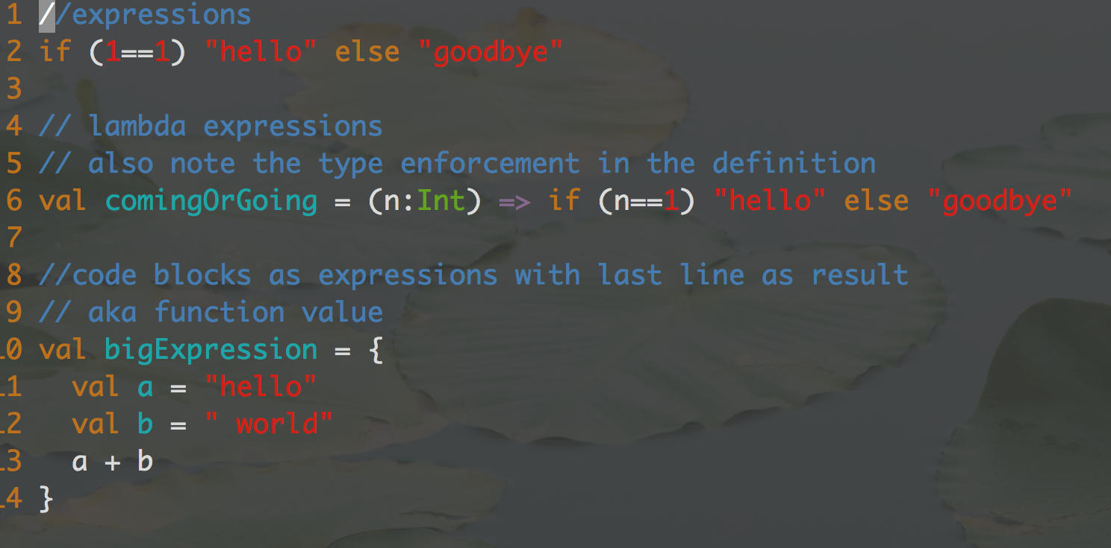
Expressions
simpleSyntaxExamples.scala

Slide 23
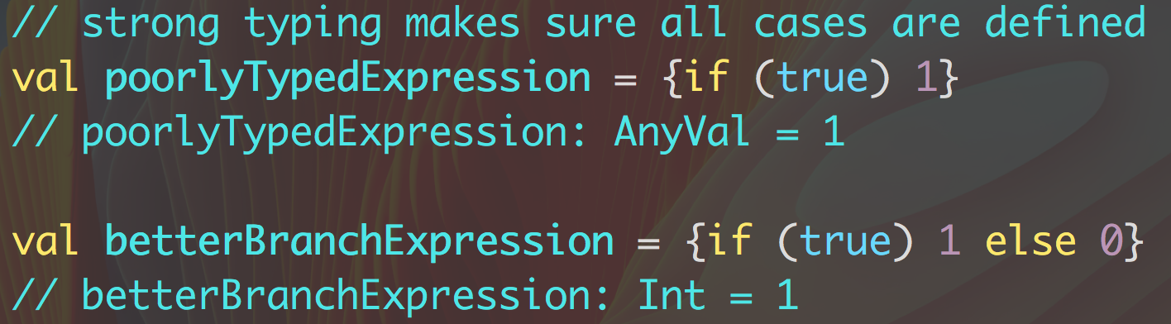
Strong Typing in Expressions

Slide 24
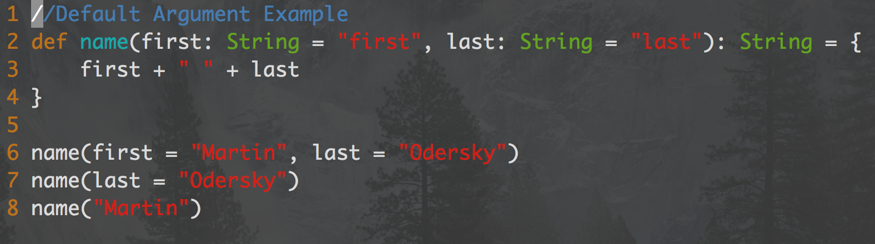
Methods
Methods can contain default values
Output Type can be inferred or explicit (many prefer explicit typing)
simpleSyntaxExamples.scala

Slide 25
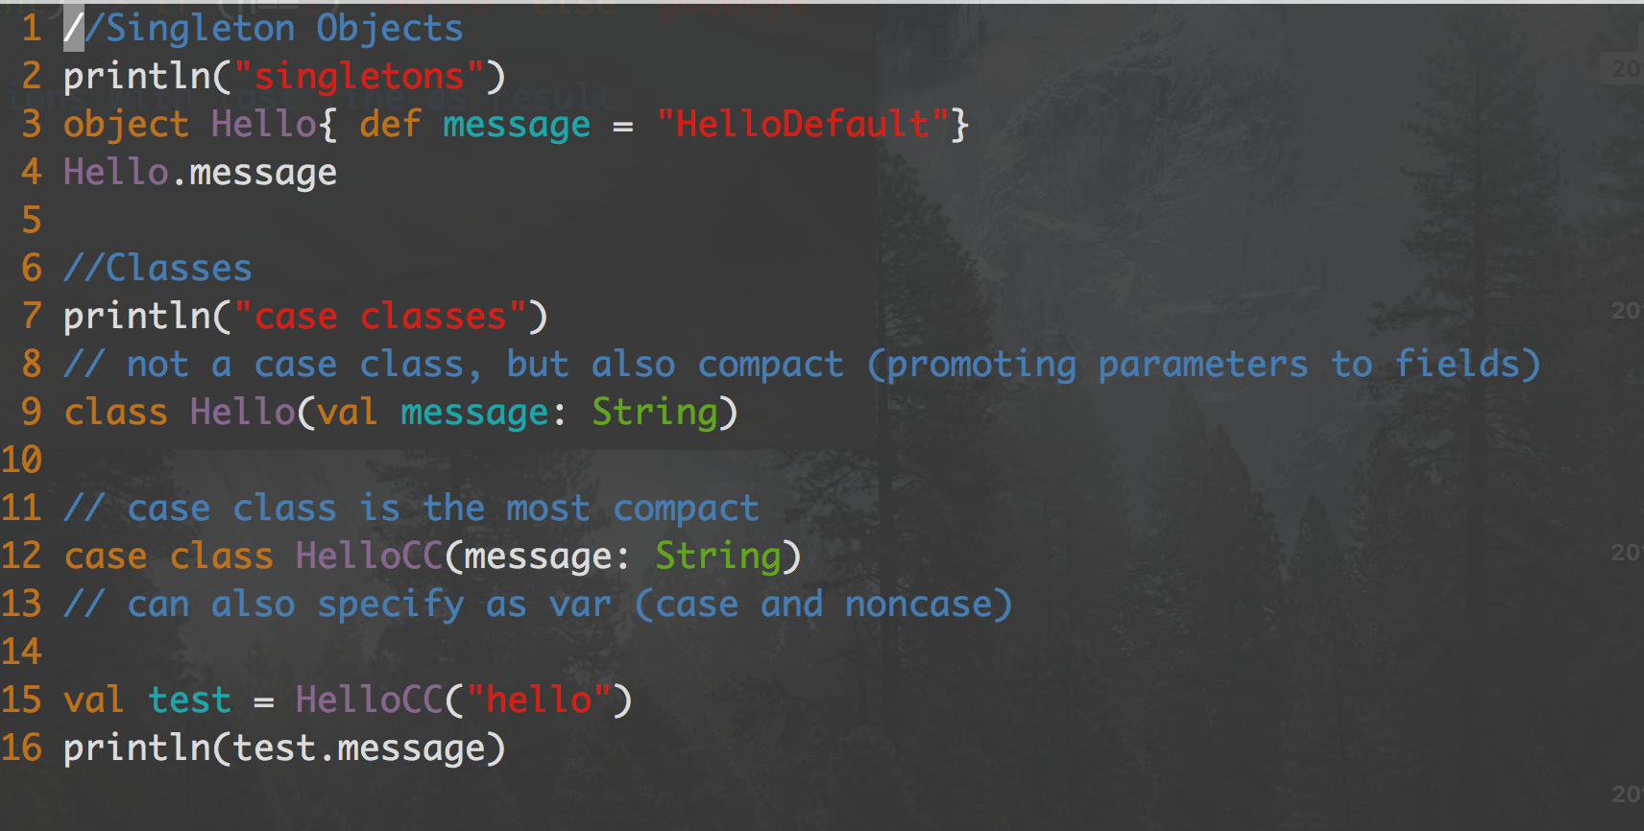
Defining Classes
simpleSyntaxExamples.scala

Slide 26
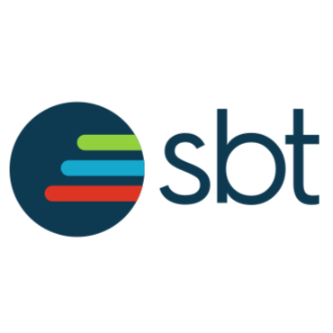
Simple Build Tool (sbt)
The “maven” of scala
Interactive shell or command line
Shell can be converted to scala console
Continuous compilation (~compile)
A portable jar file (assembly) can be created
SBT is the native compiler for scala
Spark compiles in both, with the maven build tool currently recommended
Most contributors prefer sbt based on the continuous compilation
Show lambda example

Slide 27
Collections in Scala
https://docs.scala-lang.org/overviews/collections/overview.html

Slide 28
Collections in Scala: Immutable
https://docs.scala-lang.org/overviews/collections/overview.html

Slide 29
Collections in Scala: Mutable
https://docs.scala-lang.org/overviews/collections/overview.html

Slide 30
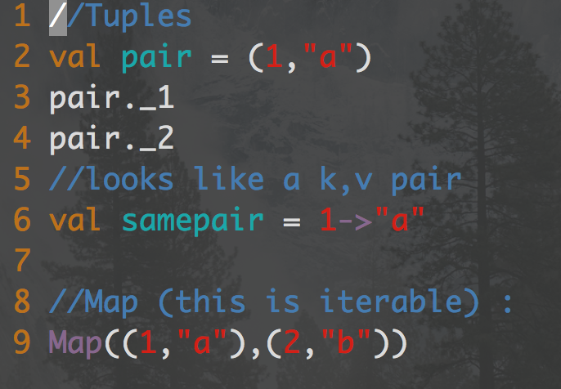
Operations on Collections
A Tuple is not a collection!

Slide 31
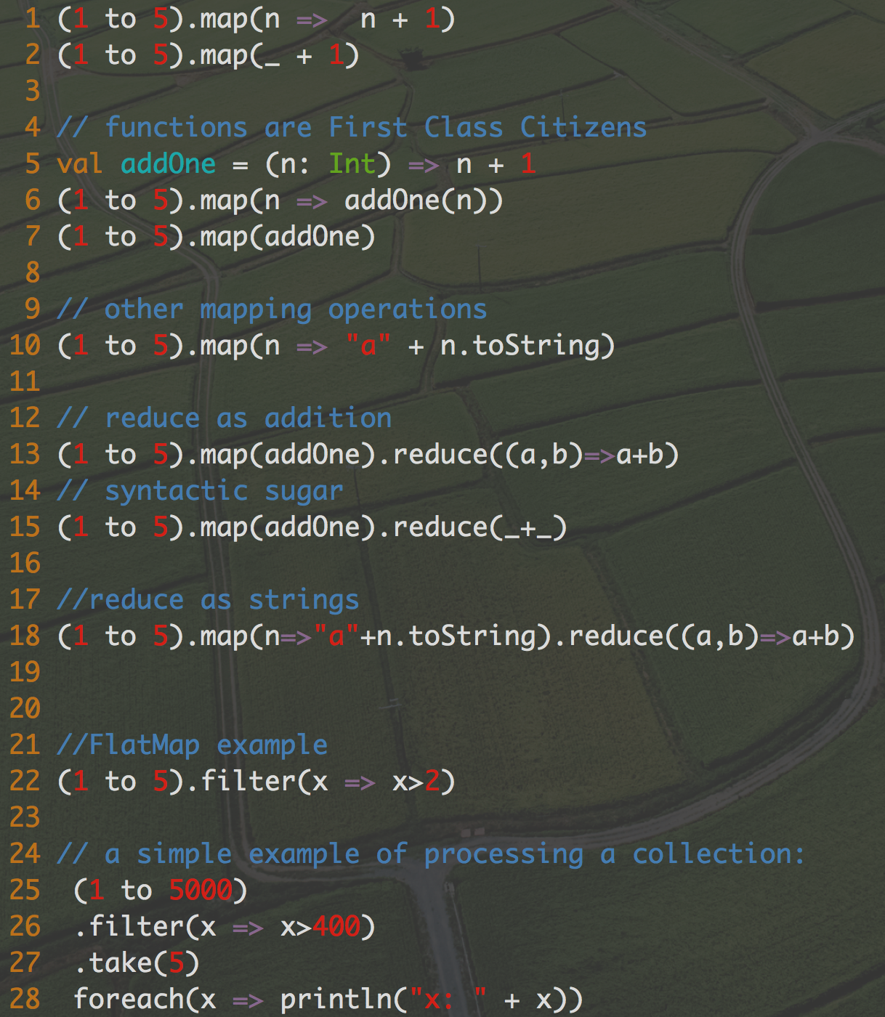
Operations on Collections…
Map, reduce, filter, and foreach….

Slide 32
Operations on Collections……
Map, reduce, filter, and foreach….

Slide 33
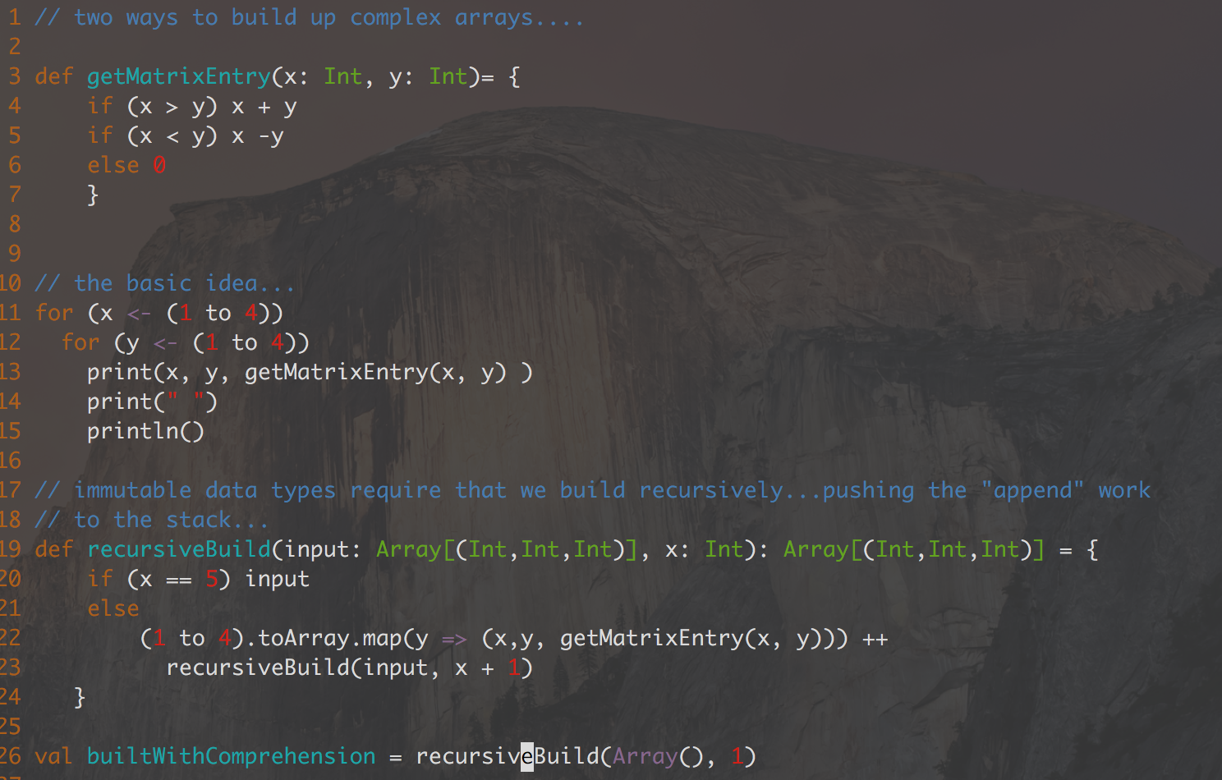
Creating Collections in Scala while preserving immutability….
waysToBuildComplexCollections.scala

Slide 34
Creating Complex Collections in Scala
This is closer to what you would see in a procedural language…
It pushes work to the stack
It does not leverage parallelism
waysToBuildComplexCollections.scala

Slide 35
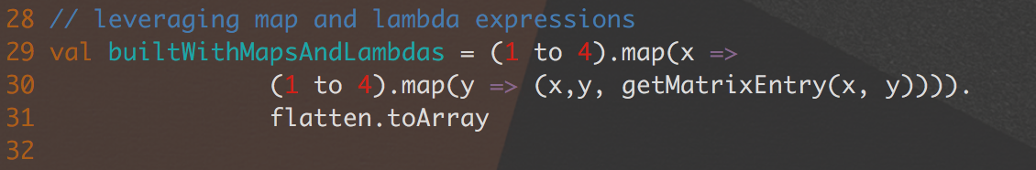
Creating Complex Collections in Scala
This is a more functional approach“map” usually has under the hood optimizations
It can be harder to write for more complex cases.
waysToBuildComplexCollections.scala

Slide 36
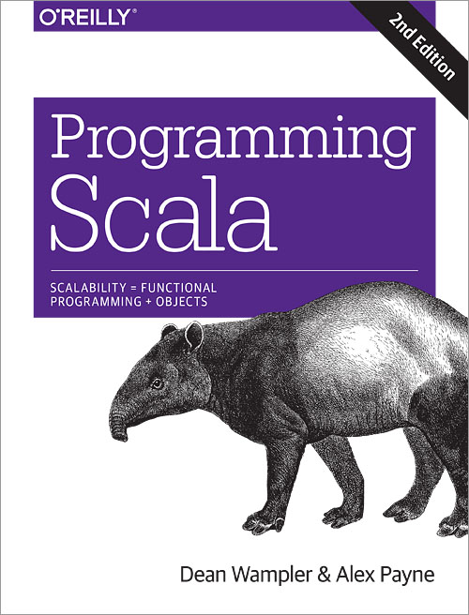
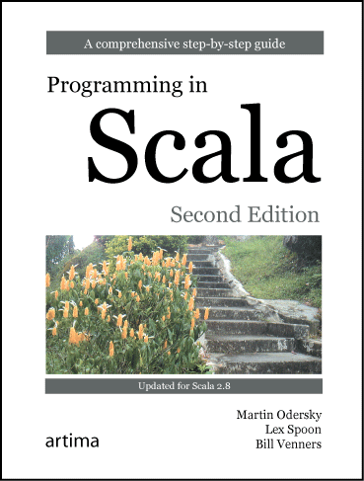
Further Reading
Online:
Coursera Course on Scala by Martin Odersky (new one coming online soon!)
My favorite scala site (thanks to Dean Wampler): http://aperiodic.net/phil/scala/s-99/

Slide 37
Components of Spark

Slide 38
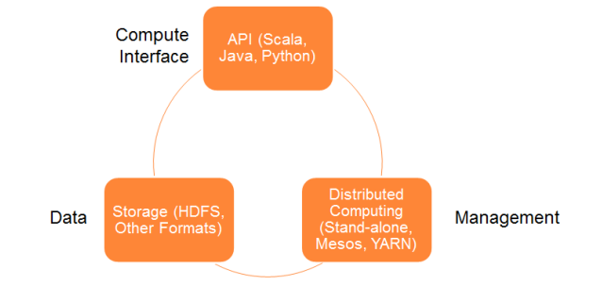
Components of a Spark Application
3 main components:
Data Storage: Any Hadoop compatible data source and more
API: Scala, Java, Python
Cluster Management Framework: Stand-alone server or Mesos or YARN

Slide 39
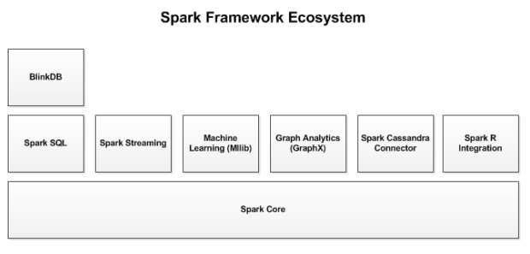
Spark Ecosystem

Slide 40
Spark Core
Base engine for large scale parallel and distributed data processing
Task scheduling
Memory management
Fault recovery
Interacting with storage systems, and more.
Houses API that defines RDDs, distributed collection of elements that is parallelized across the cluster.

Slide 41
Spark Cluster Managers
Cluster managers allocate resources across applications on a cluster
Currently supports three cluster managers:
Standalone – a simple cluster manager included with Spark that makes it easy to set up a cluster.
Apache Mesos – a general cluster manager that can also run Hadoop MapReduce and service applications.
Hadoop YARN – Yet Another Resource Negotiator. The native hadoop cluster manager.manager in Hadoop 2.

Slide 42
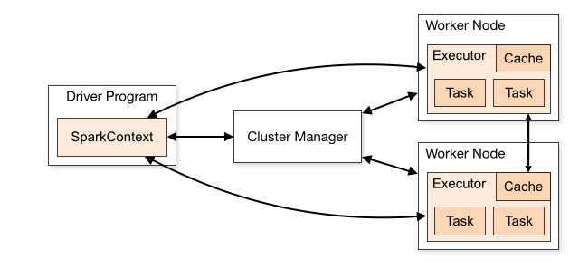
Components of a Spark program
A Spark program is two programs: driver program and executor program
Executor programs run on cluster nodes called worker nodes or in local threads
RDDs are distributed across workers
Communication occurs between a driver and executors
Driver has Spark jobs that it needs to run
Jobs are split into tasks that are submitted to the executors for completion
Results from these tasks are delivered back to the driver.
How Spark runs on clusters

Slide 43
Glossary of cluster concepts
Application: User program built on Spark. Consists of a driver program and executors on the cluster
Driver program: The process running the main() function of the application and creating the SparkContext
Cluster Manager: An external service for acquiring resources on the cluster
Worker node: Any node that can run application code in the cluster
Executor: A process launched for an application on a worker node, that runs tasks and keeps data in memory or disk storage across them. Each application has its own executors
Task: A unit of work sent to one executor
Job: A parallel computation consisting of multiple tasks that gets spawned in response to a Spark action
Stage: Each job gets divided into smaller sets of tasks called stages that depend on each other

Slide 44
SparkContext
Main entry point to everything Spark.
Defined in the main/driver program
Tells Spark how and where to access a cluster
Connects to cluster managers
Coordinates Spark processes running on different cluster nodes
Used to create RDDs and shared variables on the cluster.
Automatically initialized in Spark shell for Python and Scala, need to be defined explicitly in Java

Slide 45
Spark shell – Python, Scala
Provides a simple way to learn Spark API
Powerful tool to analyze data interactively
Available in Python and Scala
Run “pyspark” to start Python shell
Run “spark-shell” to start Scala shell
SparkContext is automatically initialized and is available as “sc” in both Python and Scala shells

Slide 46
Resilient Distributed Datasets

Slide 47
Resilient Distributed Datasets
Three methods for creating RDD:
Parallelize existing collection, example: lists
From files on other external storage system
Transformation from an existing RDD
Dataset from any storage including local file system, Cassandra, Hbase, HDFS, Amazon S3 etc
Types of files supported: text files, SequenceFiles, Avro, Parquet and any other Hadoop InputFormat
Spark’s primary data abstraction
Fault tolerant collection of elements
Can be operated in parallel
Immutable once constructed

Slide 48
RDD Operations: Transformations and Actions
Transformations:
Create new RDD from existing one
Lazy evaluation
Actions:
RDDs are evaluated when action is called
Mechanism to get results out of Spark onto driver

Slide 49
RDD Operations: Transformations and Actions
The Directed Acyclic Graph (DAG)
When RDD is created, a DAG is created.
DAG is not evaluated until an action is called, thus lazy evaluation
When a transformation is called, the DAG is updated and the pointer to the transformed RDD is returned
When a node goes down, DAG is replicated and this node is restored. Hence fault tolerant nature of RDDs

Slide 50
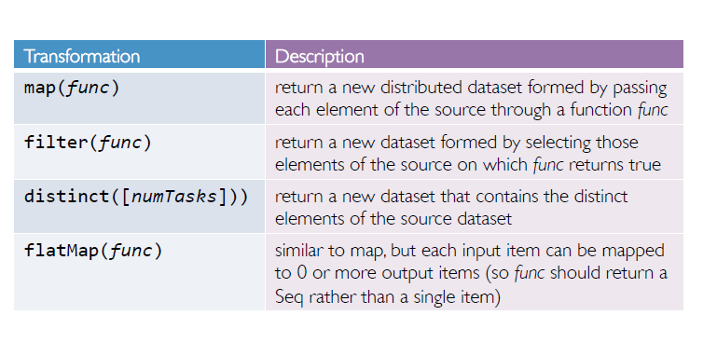
RDD Transformations

Slide 51
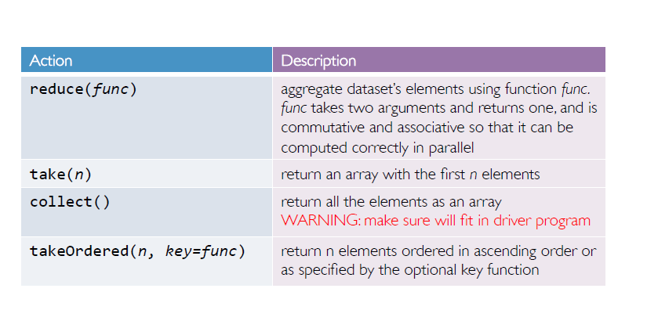
RDD Actions

Slide 52
RDD Operations Demo
Structured Data Processing using Data Frames

Slide 53
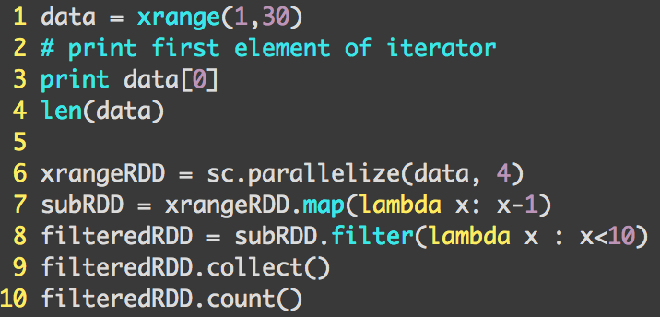
firstDemo.py In Pyspark shell:

Slide 54
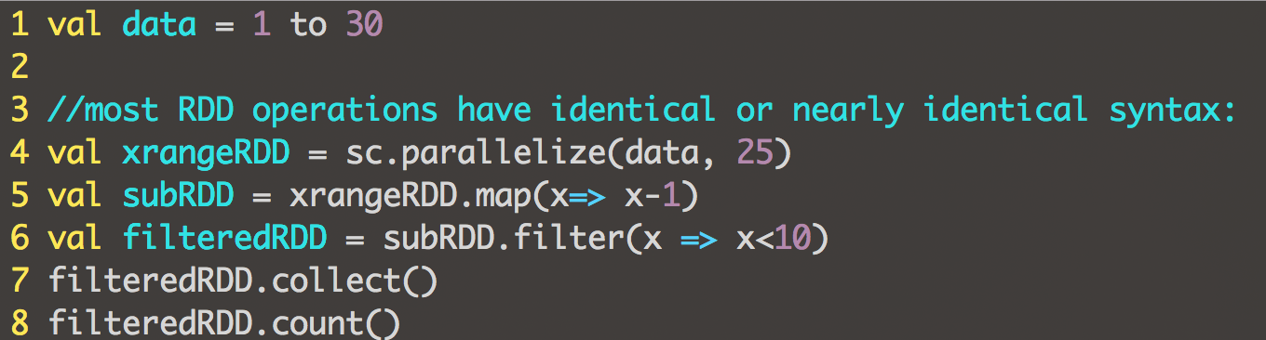
firstDemo.scala in spark-shell:

Slide 55
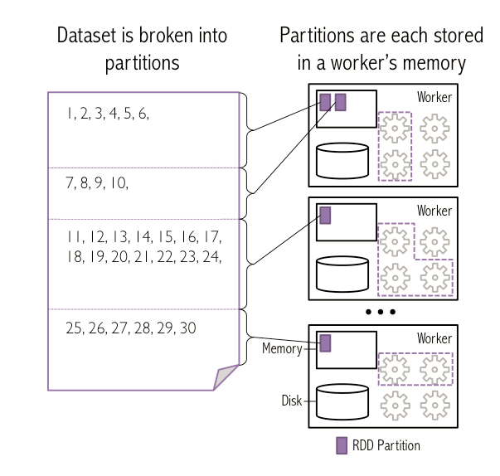
RDD creation

Slide 56
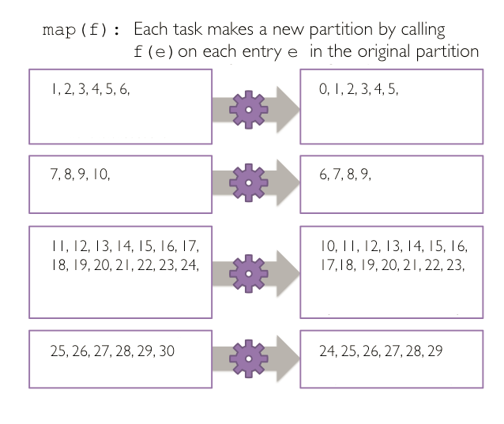
RDD transformation: map

Slide 57
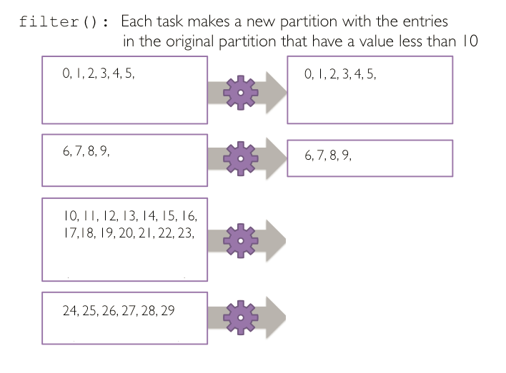
RDD transformation: filter

Slide 58
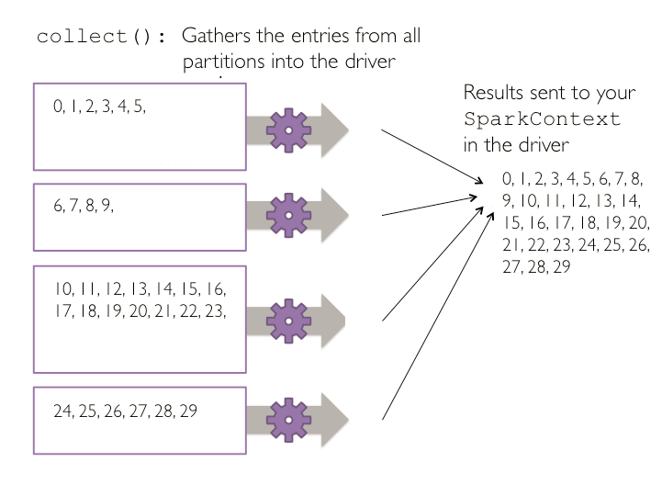
RDD transformation: collect

Slide 59
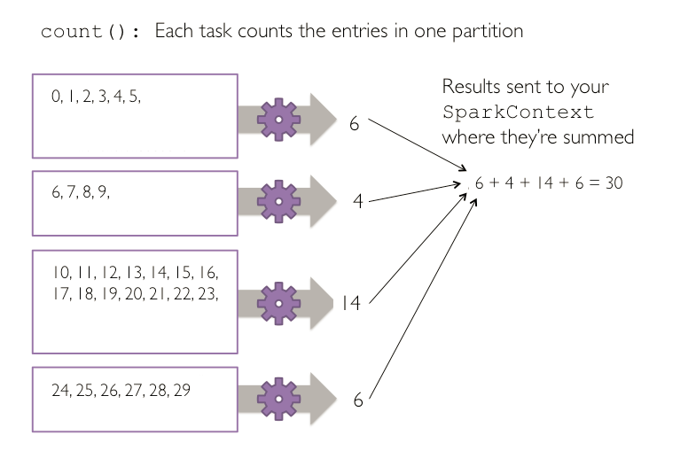
RDD Action: count

Slide 60
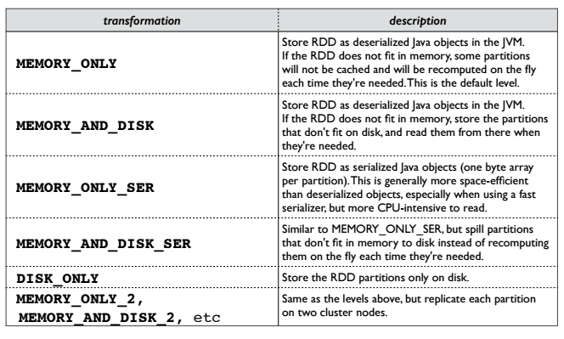
Spark Persistence
Can persist or cache dataset in memory across operations
Each node stores in memory slices of dataset
Cache is fault-tolerant

Slide 61
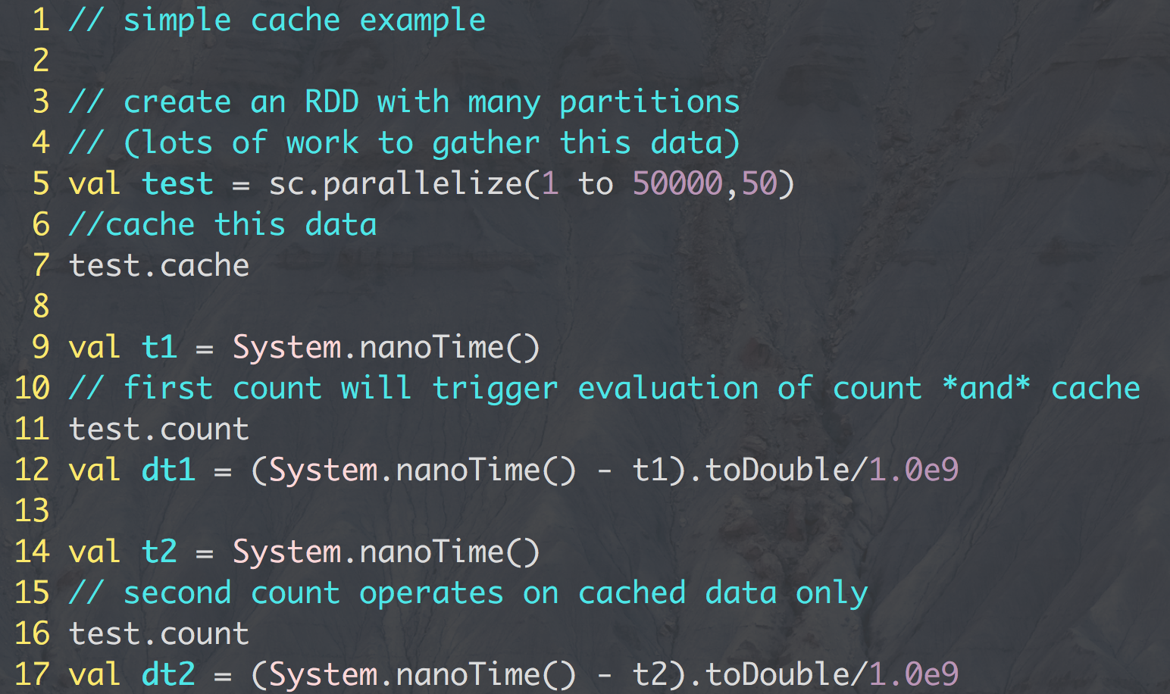
simpleCache.scala
Spark UI:
localhost:4040

Slide 62
Spark Ecosystem

Slide 63
Spark Ecosystem

Slide 64
Spark SQL
Spark module acting as a distributed SQL query engine
Used for structured data processing and allows running SQL like queries
Data from different formats like JSON, Parquet, Database is operational
Allows combining SQL with Spark’s programming API
Can perform ETL on data and then run ad-hoc querying.
2 main components:
DataFrame: distributed collection of data organized into named columns
SQLContext: encapsulates all relational functionality in Spark.

Slide 65
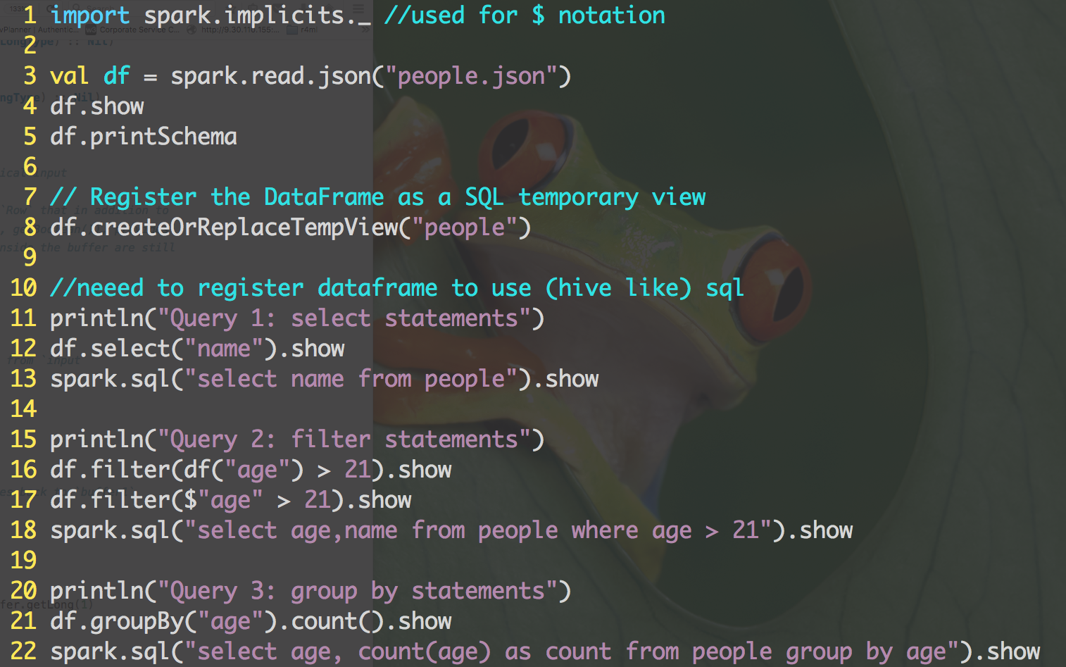
dataframesDemo.scala
Selection
Filtering
Aggregation

Slide 66
Spark MLLib Demo:
Using K-means to cluster data

Slide 67
Spark MLLib
Spark’s machine learning (ML) library.
Goal is to make ML scalable and easy
Includes common learning algorithms and utilities, like classification, regression, clustering, collaborative filtering, dimensionality reduction
Includes lower-level optimization primitives and higher level pipeline APIs
Divided into two packages
Spark.mllib: original API built on top of RDDs
Spark.ml: provides higher level API built on top of DataFrames for constructing ML pipelines

Slide 68
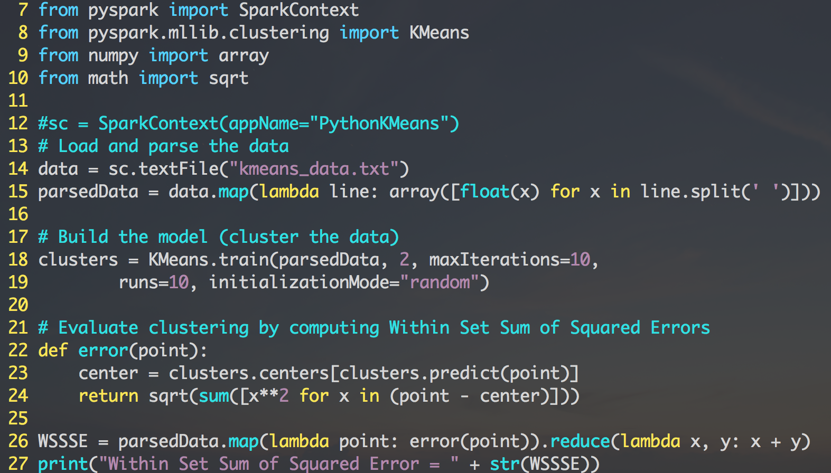
kMeansDemo.py in Python

Slide 69
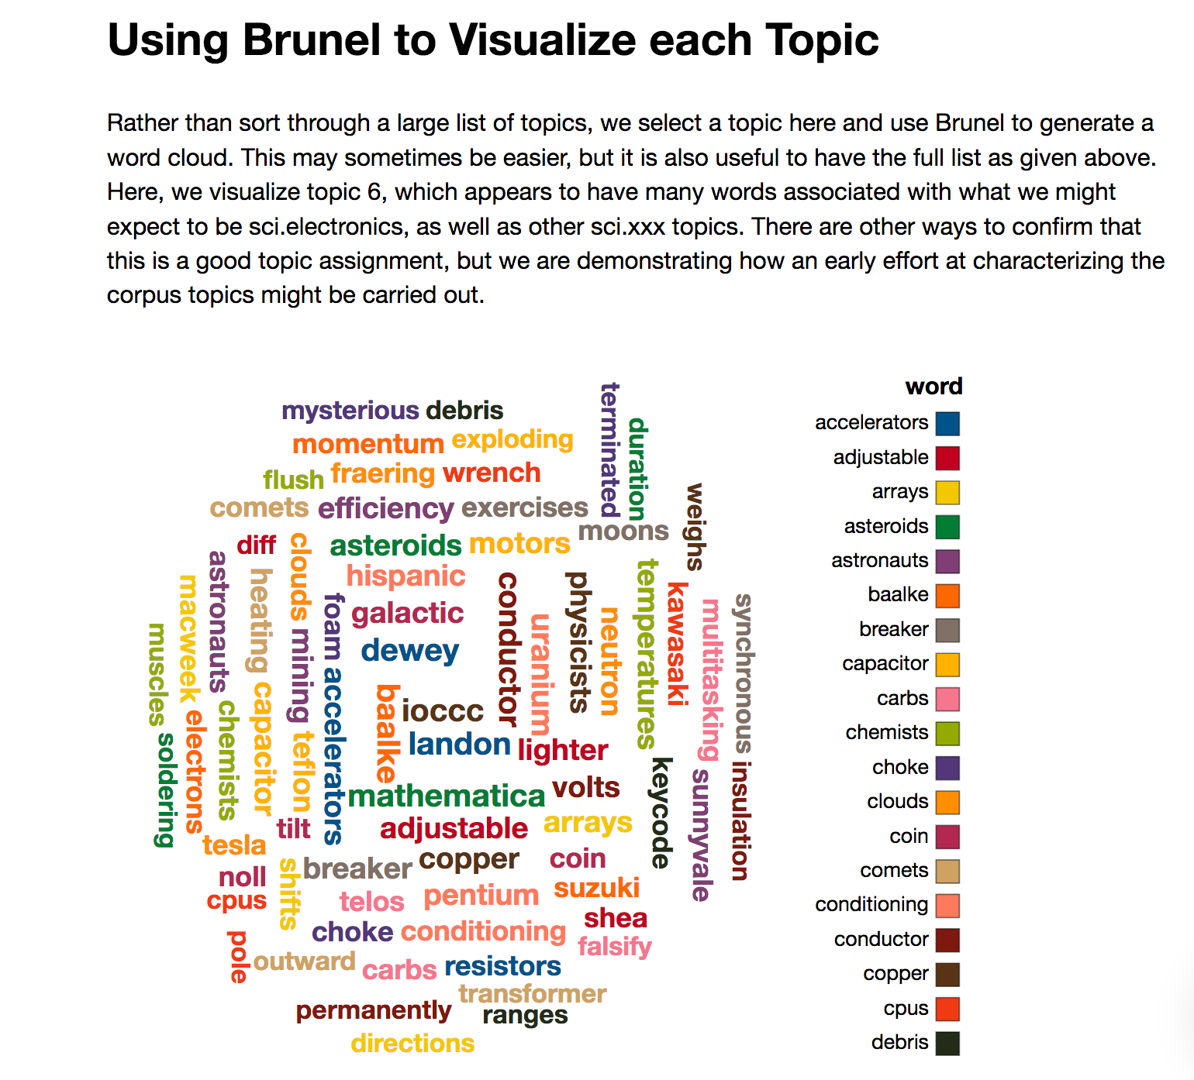
Topic Modeling with Spark
http://bit.ly/LDAwithPretrainedModel
We used the yahoo news corpus of 20k models. Training took ~20min on a 4 node Spark cluster, and we are looking at a pretrained model here.

Slide 70
ML Pipelines
ML Pipelines operates on dataframes in a way that makes for a more organized machine learning workflow. Here are the basic terms:
DataFrame: This ML API uses DataFrame from Spark SQL as an ML dataset, which can hold a variety of data types. E.g., a DataFrame could have different columns storing text, feature vectors, true labels, and predictions.
Transformer: A Transformer is an algorithm which can transform one DataFrame into another DataFrame. E.g., an ML model is a Transformer which transforms a DataFrame with features into a DataFrame with predictions.
Estimator: An Estimator is an algorithm which can be fit on a DataFrame to produce a Transformer. E.g., a learning algorithm is an Estimator which trains on a DataFrame and produces a model.
Pipeline: A Pipeline chains multiple Transformers and Estimators together to specify an ML workflow.
Parameter: All Transformers and Estimators now share a common API for specifying parameters.

Slide 71
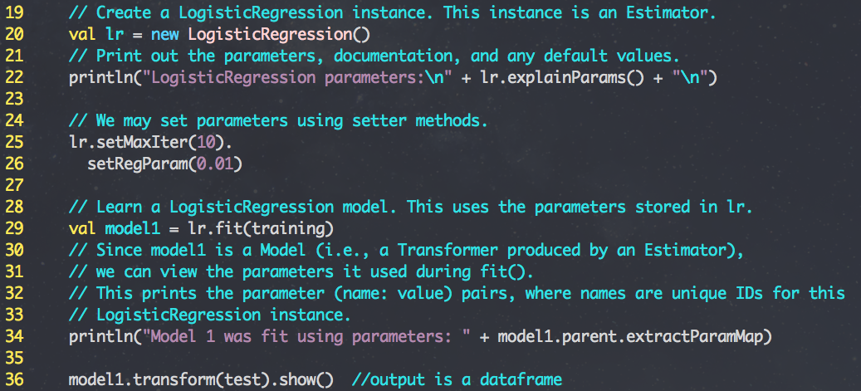
Estimators and Transformers
EstimatorTransformer.scala

Slide 72
Pipelines

Slide 73
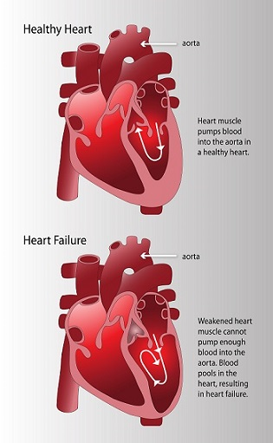
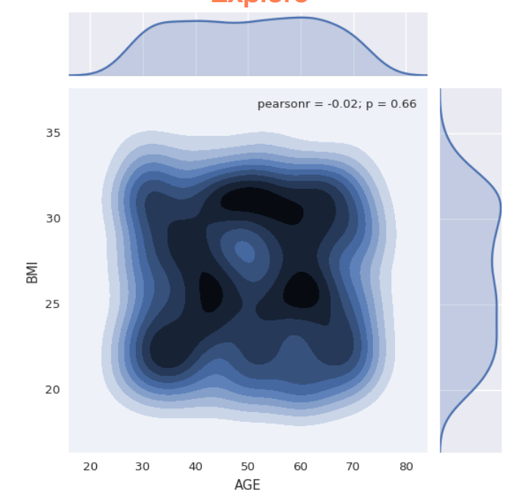
ML Pipelines in Python
http://bit.ly/MLPipelinesWithPython
https://github.com/justinmccoy/watson-dojo-pm-tester

Slide 74
SystemML

Slide 75


Apache SystemML
Goal: Take the linear algebra formulation of an algorithm and make it scale automatically
IBM Research technology, now an open-source Apache project.
Try SystemML online on the IBM Data Science Experience: http://datascience.ibm.com
http://systemml.apache.org
Now a Top Level Apache Project!
]
Notes:
-SystemML makes writing code in the linear algebra more seamless and easy.
-Currently SystemML is an Apache incubating project.
-Automatic Optimization based on data and cluster characteristics to ensure both efficiency and scalability
-DML lang: declarative machine learning language
Latest state of the art, Spark
In memory distributed MR like framework
Various API support like Scala, Java, Python and R
System-ML
Library for Customized machine learning on Large Scale data
It has a compiler which will analyze, optimize, and create the spark based MR plan to be run on the cluster.
Focus on the simple, fortran and R like syntax
R
R has been the de-facto tools and standard for analyzing the stats and ML

Slide 76
Linear Algebra is the Language of Machine Learning.
w3
IBM
Linear algebra is
powerful,
precise,
and high-level.
Express complex transformations over large arrays of data…
…in a clear and unambiguous way
…using a small number of instructions.
Notes:
Let me introduce why systemML is needed. Lets talk about linear algebra and why it is so important for the machine learning.

Slide 77
The R Language: Linear algebra as a first-class citizen
Matrix Multiply Operator Returns a Matrix
> 3 * 2
[1] 6
> 3 %*% 2
[,1]
[1,] 6

Slide 78
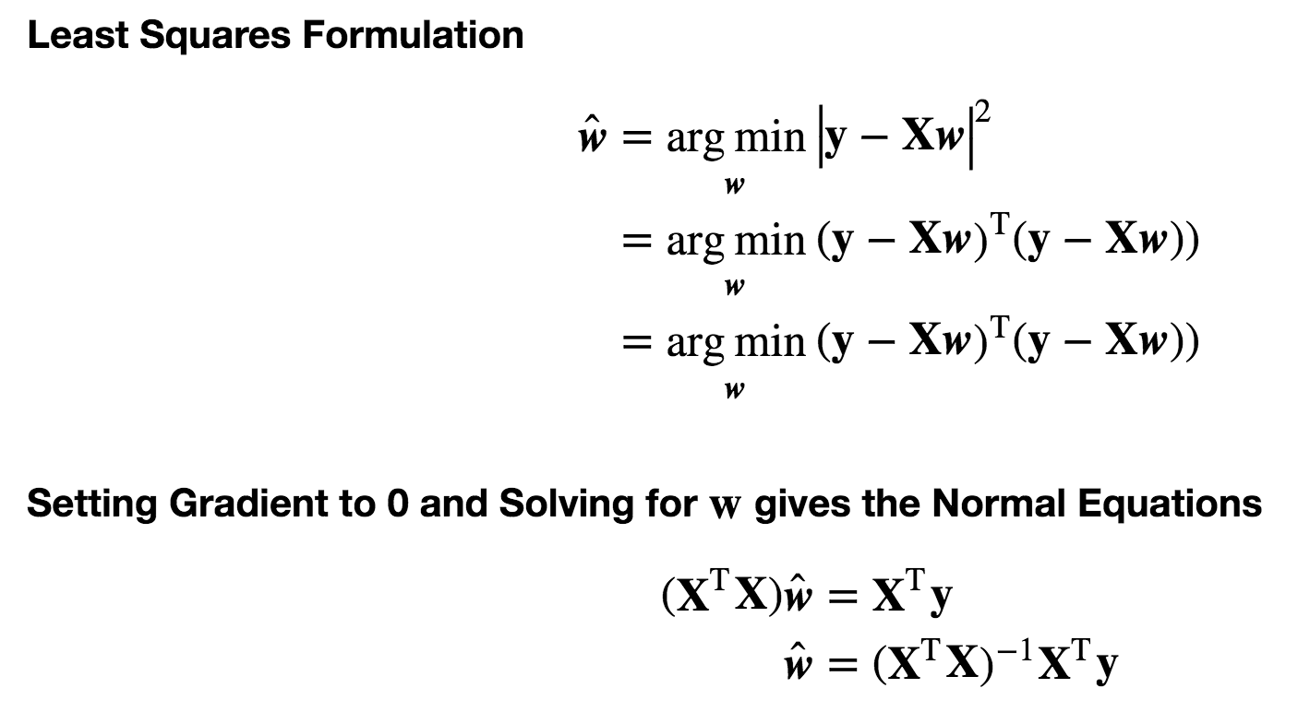
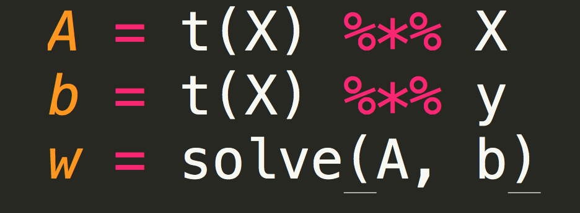
Declarative Machine Learning (DML)
DML allows for rapid prototyping of algorithms at scale that closely resemble the mathematical representation

Slide 79
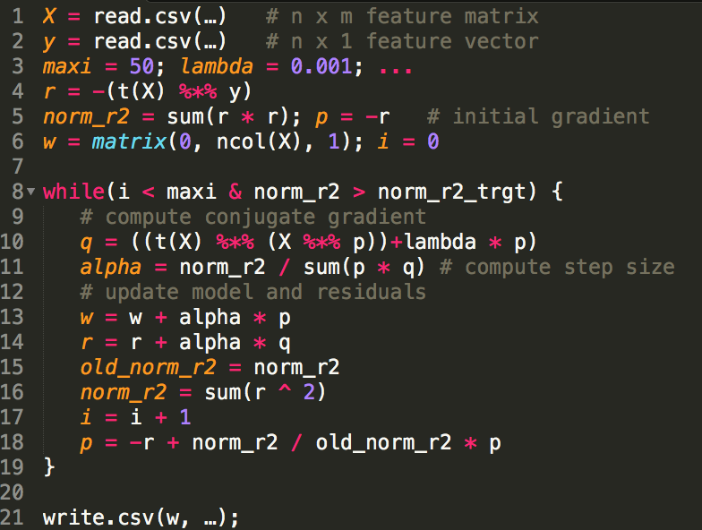
Declarative Machine Learning (DML)
L₂ regularized linear regression by the conjugate gradient method in DML:

Slide 80


Image Classification with Deep Learning
Apache SystemML Application
Mike Dusenberry and Fred Reiss
Gradient Descent
Raw Data
Goodness
of Fit
Data Cleaning
Neural Networks
Low-Level Features
High-Level Features
Dim. Reduction
Model Training
Model

Slide 81
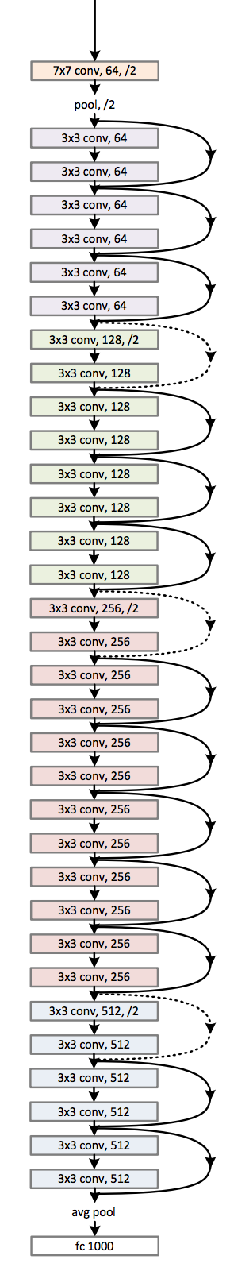
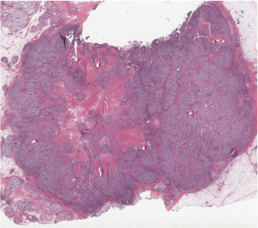
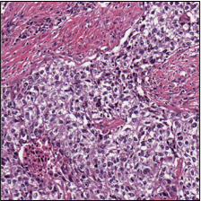
Breast Cancer Pathology
Apache SystemML Application
Mike Dusenberry and Fred Reiss
Filtered Tile Image
Tile Samples
Image Tiles
Apache SystemML Application
Tumor Proliferation
Score
Sample Image

Slide 82
Getting Started with SystemML
Course Materials Link: http://bit.ly/DSatESwithSpark
Go to http://systemml.apache.org/download
Download systemml-0.14.0-incubating.tgz (Binary tgz)
Unzip to location and add
“export SYTEMML_HOME=/my/path/systemml-0.14.0/” to ~/.bash_profile
At command line type
$SPARK_HOME/bin/spark-shell --jars $SYSTEMML_HOME/libs/systemml-0.14.0-incubating.jar
Or
bash startSparkWithSystemML.sh (which has some recommended memory settings)
Try importing systemml at REPL: scala> import org.apache.sysml
Browse Notebook Examples on github! http://systemml.apache.org/get-started

Slide 83
SystemML Demo
Using K-means to cluster data

Slide 84
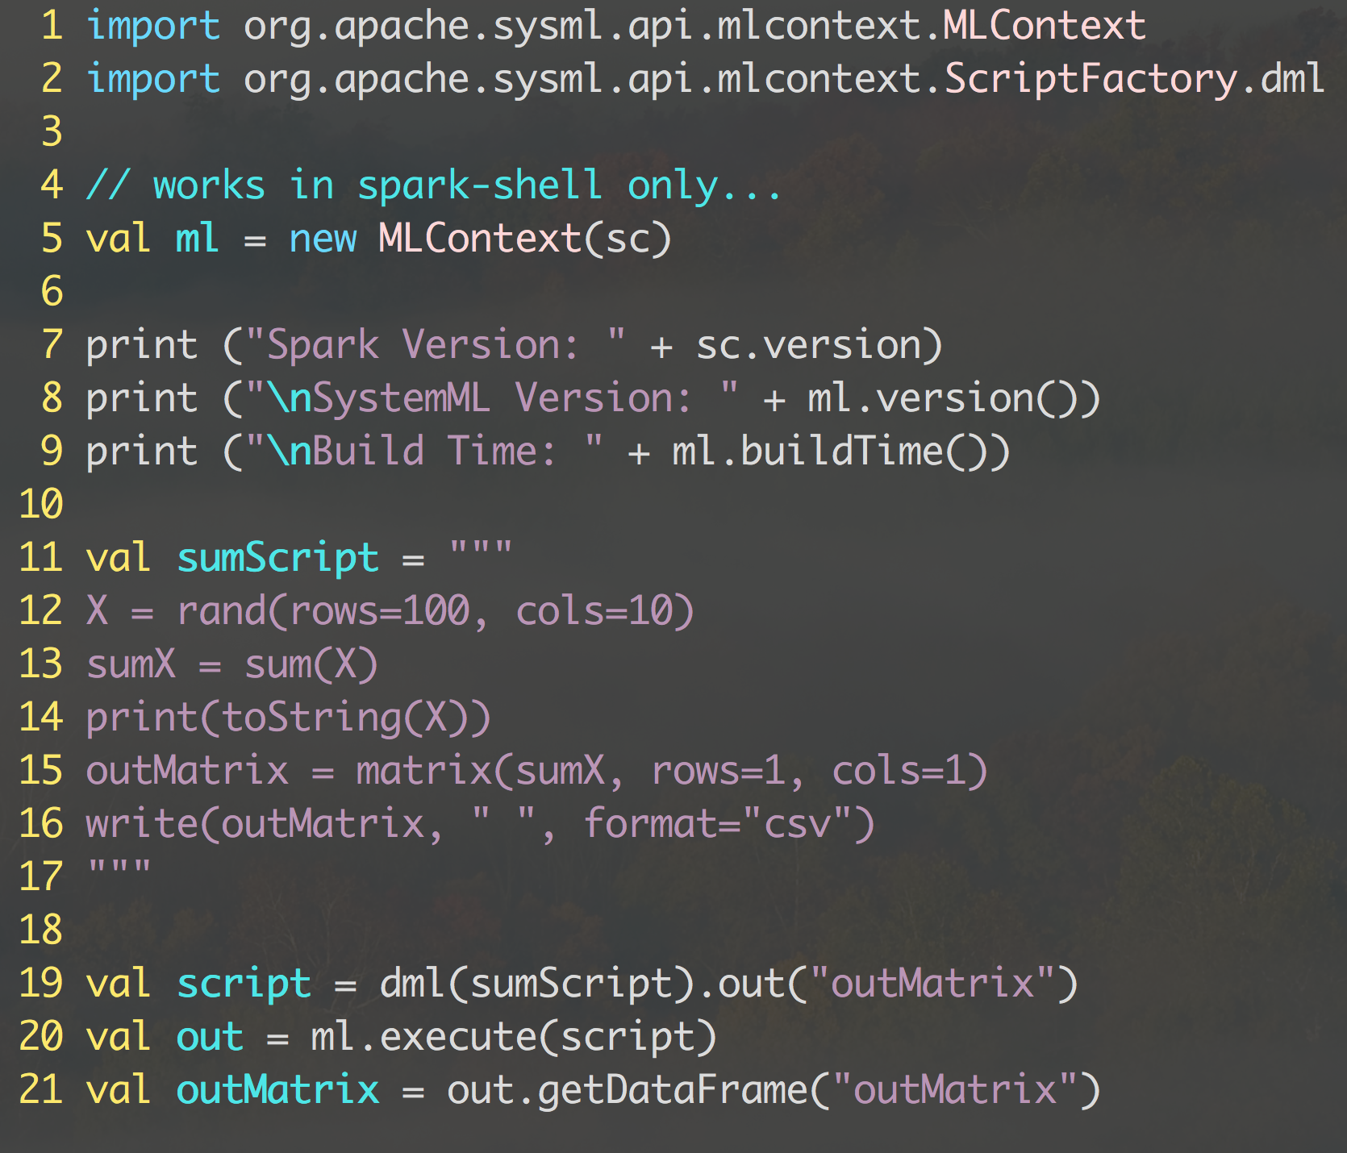
inlineDMLDemo.scala
DML Defined inline here

Slide 85
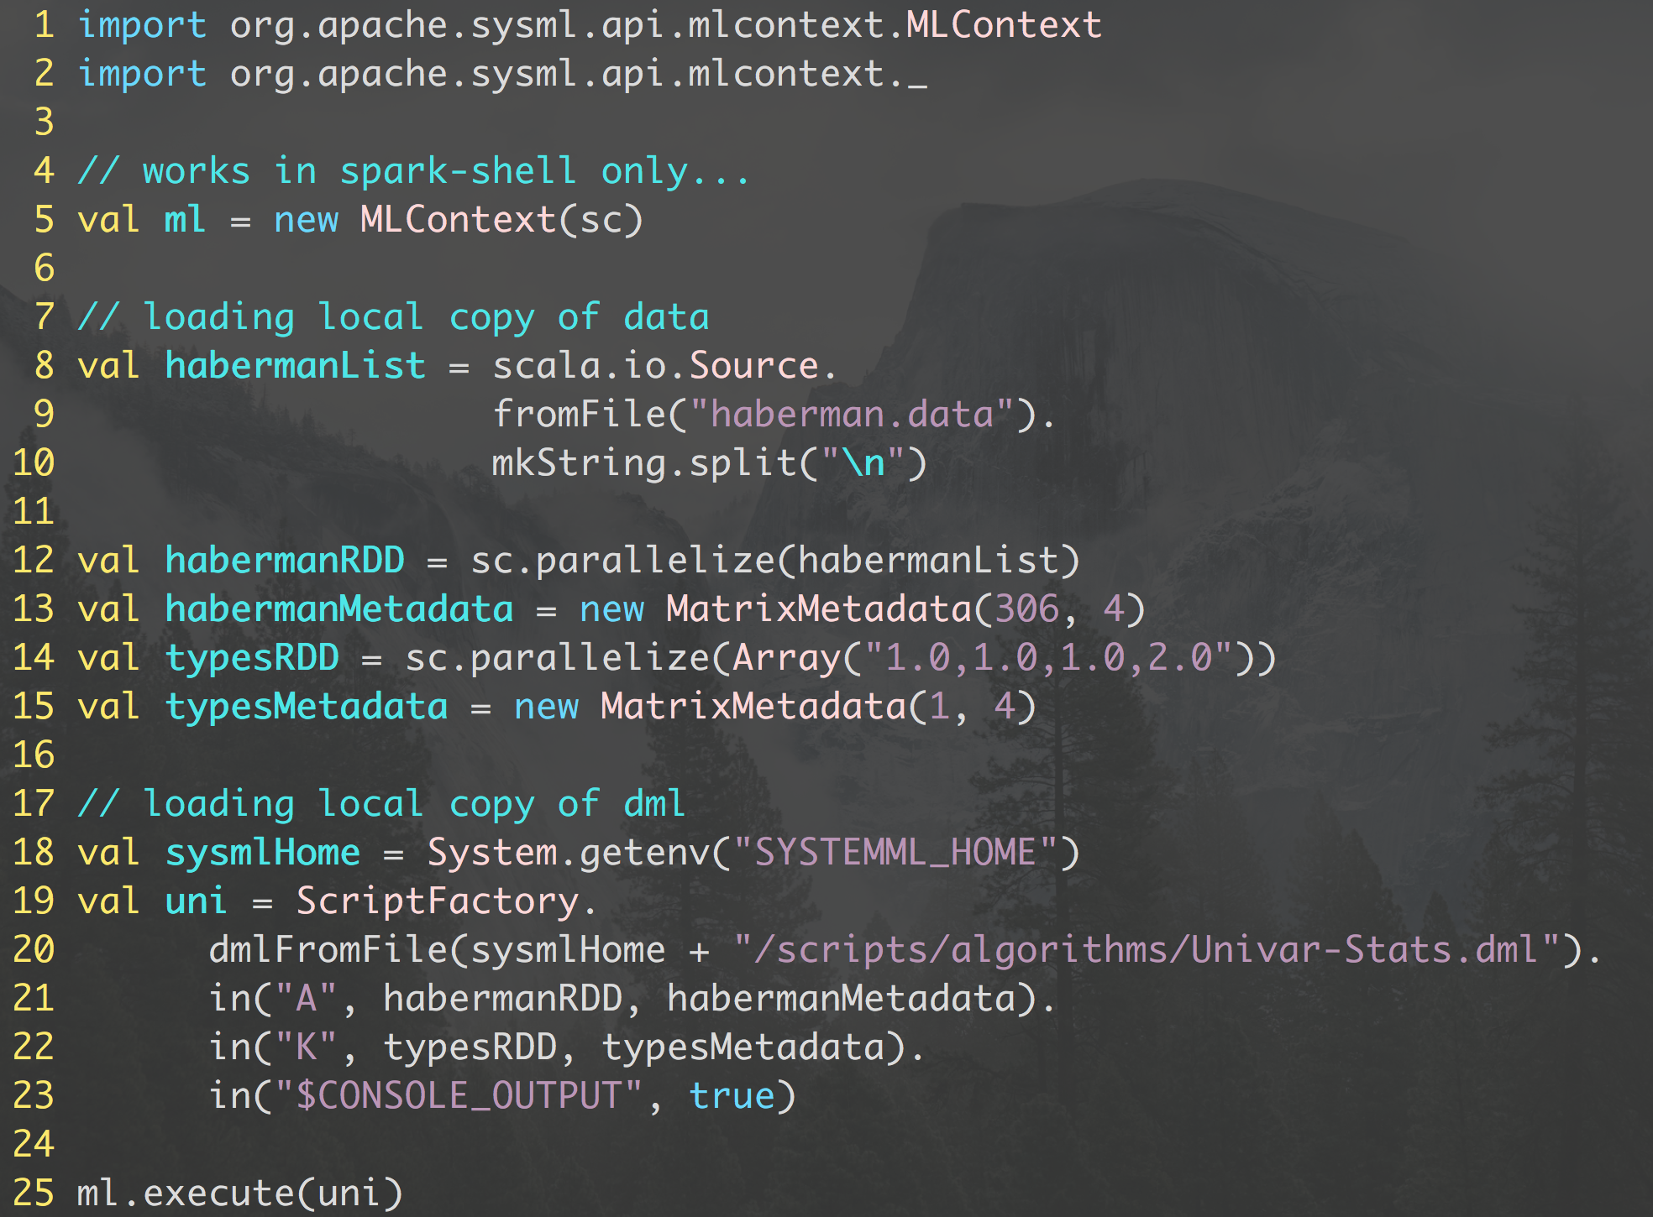
fromFileDMLDemo.scala

Slide 86
Live (Notebook) Demo:
Go to systemMLExamples directory…launch jupyter-notebook. 2 notebooks should be visible:
1) Linear Regression Algorithms Demo.ipynb
2) Deep Learning Image Classification.ipynb
Browse More Notebook Examples on github: http://systemml.apache.org/get-started

Slide 87
Spark GraphX Demo
Using K-means to cluster data

Slide 88
Spark GraphX
Graph processing library with APIs to manipulate graphs and performing graph-parallel computations
Like RDDs, property graphs are immutable, distributed, and fault-tolerant.
Provides various operators for manipulating graphs (e.g., subgraph and mapVertices)
Provides library of common graph algorithms (e.g., PageRank and triangle counting

Slide 89
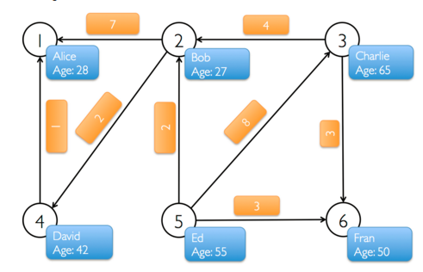
GraphX demo in Scala
fineertex array and edge aray
Construct RDDs from vertex and edge arrays
Build a Property graph using RDD of vertices and edges
Perform filter operation on graph. Example: list users at least 30 years of age
Use the graph.triplets view to display relationships in the graph

Slide 90
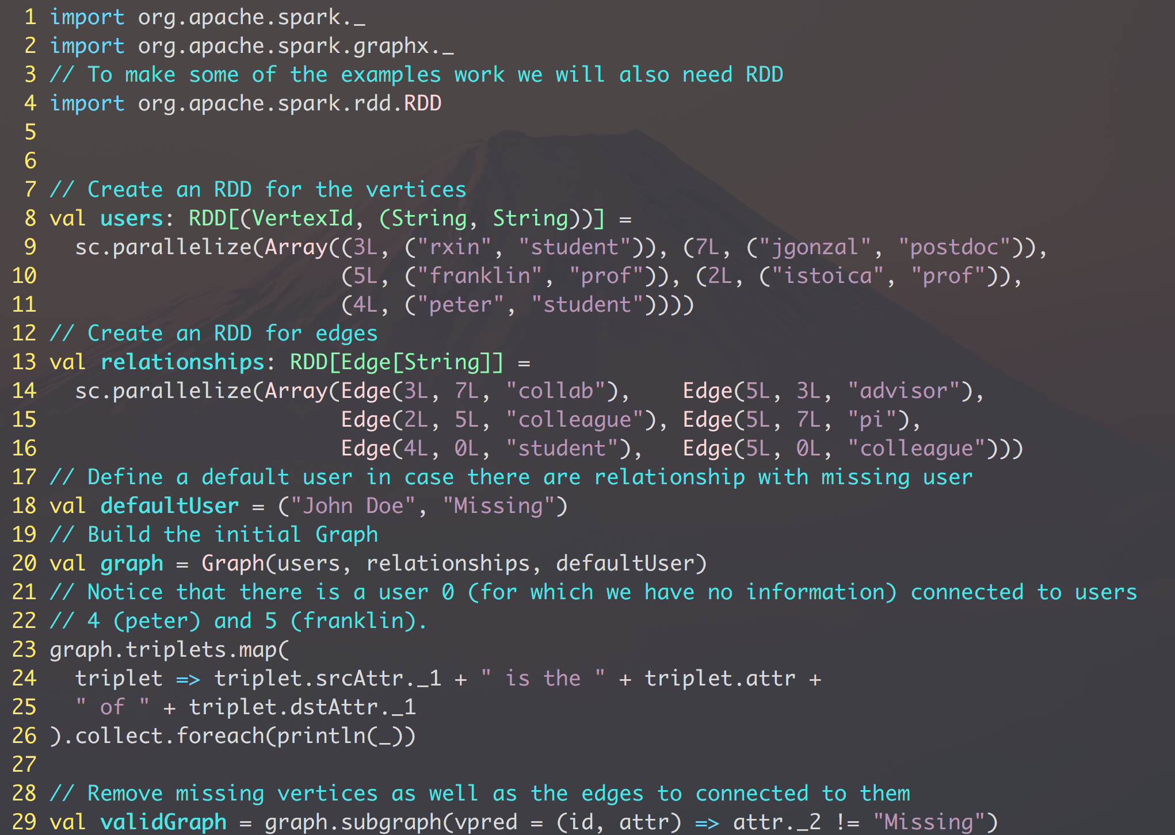
simpleGraphDemo.scala
Exploring the basics of graph structure in Spark!

Slide 91

loadClickStreamData.scala runAndWriteClickGraph.scala
Analyzing Wikipedia Clickstream DataVanu Pilim
https://old.datahub.io/dataset/wikipedia-clickstream
To visualize output…go to site/
Launch server: python –m SimpleHTTPServer
or python3 -m http.server
Browse to: localhost:8000

Slide 92

clickStream Analysis
Analyzing Wikipedia Clickstream DataVanu Pilim
https://old.datahub.io/dataset/wikipedia-clickstream

Slide 93
loadClickStreamData.scala runAndWriteClickGraph.scala
Analyzing Wikipedia Clickstream DataVanu Pilim
https://old.datahub.io/dataset/wikipedia-clickstream
To visualize output…go to site/
Launch server: python –m SimpleHTTPServer
or python3 -m http.server
Browse to: localhost:8000

Slide 94
Spark Streaming Demo
Using K-means to cluster data

Slide 95

Spark Streaming
Extension of the core Spark API that enables scalable, high-throughput, fault-tolerant stream processing of live data streams
Data can be ingested from many sources like Kafka, Flume, Twitter, ZeroMQ, Kinesis, or TCP sockets
Data processed using MLLib, Graph processing ir high level functions like map, reduce, join, window etc
Processed data can be pushed out to file systems, databases and live dashboards

Slide 96

simpleStreamDemo.scala
In a separate terminal…launch
nc –lk 9999
After running this script type:
scala> ssc.start

Slide 97
SparkR and R4ML: Connecting Spark, SystemML and R

Slide 98


Lead Architects
Alok Singh
Principal Engineer at the IBM Spark Technology Center. He is leading the R4ML team at IBM. He has built/architected analytical frameworks and implemented various machine learning algorithms.
Interests: Big Data, Scalable Machine Learning Software, and Algorithms.
Fred Reiss
Apache SystemML Committer.
2006: Ph.D. from U.C. Berkeley.
2006-2014: Worked for IBM Research.
2014-present: Chief Architect, IBM Spark Technology Center.

Slide 99

SparkR is a Thin Wrapper Over Apache Spark
Fast
Statistics
+
Scalable
Packages
Flexible
Plotting
from SparkR talk by Shivaram Venkatraman (UseR! 2016)
Notes:
SparkR brings best of Spark and R together

Slide 100




R4ML
R4ML is open source and we invite all to start using it and contributing to it
https://github.com/sparkTC/r4ml
R4ML is an R-language front end to Apache SystemML that integrates seamlessly with Apache Spark’s SparkR APIs.
Notes:
R4ML is build on the top of SystemML and SparkR and the basic core engine is the Spark.
Before we go deeper into what is R4ML . Lets talk a little bit about the two open source Apache project SystemML and SparkR

Slide 101

R4ML Integrates SystemML with SparkR
Convert SparkR DataFrames into SystemML matrices.
Pass R-like code to the SystemML optimizer and execute the resulting plan.
Get back results as SparkR DataFrames.

Slide 102
R4ML Demo (DSX)
http://bit.ly/IntroR4ML
Introduction to R4ML
http://bit.ly/R4MLdemo1
Data Preparation and Dimensionality Reduction
http://bit.ly/R4MLdemo2
Support Vector Machines
http://bit.ly/R4MLdemo3
To edit these notebooks, make a copy into your own project folders.
To install on local system, see
https://github.com/sparkTC/r4ml

Slide 103
Thank You!
This is a new course…let us know how what we can improve!
Contact me at:
nilmeier@us.ibm.com
https://twitter.com/Jnilmeierlinkedin.com/in/nilmeier

